Slide 1
Natural Language and Speech Processing
Lecture 12: Tips and Tricks
Tanel Alumäe

Slide 2
Contents
Tips about data
Tips about models
Tips about training
Debugging neural networks
Other practical tips
Partly based on Andrej Karpathy’s (Head of AI at Tesla) recent blog post http://karpathy.github.io/2019/04/25/recipe/ (must read)

Slide 3
Data
Become one with data
Inspect your data carefully (spend many hours)
Understand the distribution and look at the patterns
Your brain is very good at it
Are there duplicates?
Are there corrupt examples?
Are the labels inbalanced?
Think how your brain solves this task
Can you solve this task on local context only?
Or do you need larger (global) context?

Slide 4
How much data?
Very general rule: you can start thinking about training a DNN if you have at least 1000 training samples
There is no data like more data
Common situation:
Baseline accuracy with a simple model: accuracy 60%
Super-well tuned “transformer with multi-head attention”: accuracy: 70%
Spend 1 week
Simple model with more data: 80%
Spend 2 days on data collection
Spending time on data collection is a time well spent
Can always apply new models / training tricks when they are invented
Time spent on fine-tuning a fancy model might be wasted when suddenly a new model architecture is invented

Slide 5
Data augmentation
“The next best thing to real data is half-fake data”
Data augmentation: train artificial additional training data by corrupting the real data by some domain-specific way
Often applied so that the amount of training data is increased 10 (or more) times
Data augmentation can make a huge difference, especially if domain adaptation can be performed using augmentation

Slide 6
Data augmentation, continued
For example:
Speech recognition model trained on clean data: accuracy on reverberant/noisy data 50%
Add noise and reverberate clean training data: accuracy 85%
Data augmentation is more useful in domains where input data is “continuous”
Image processing
Speech processing
Usually works better than trying to “fix” the test data (e.g., denoise)
Almost never hurts accuracy

Slide 7
Data augmentation is speech recognition
Speed perturbation
Add copies of training sentences, sped up or slown down by 10%
Simulates faster/slower speaking, but also different vocal tract characteristics
Reverberation
Add room effects (using real or artificial impulse responses)
Noise augmentation
Add background noise to (clean training data), e.g. street noise, engine, car, wind
Add “foreground noises” (e.g., door slams, claps, clicks)
Add music
Add “babble noise” (many persons speaking in the background)
All this with random signal-to-noise ratio, and many times

Slide 8
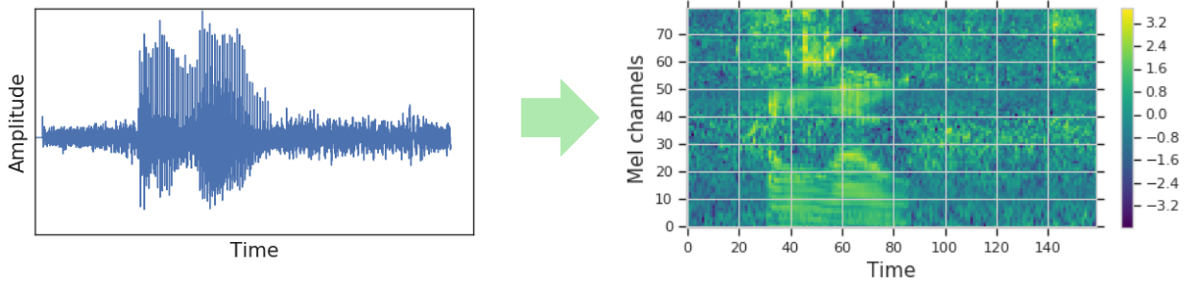
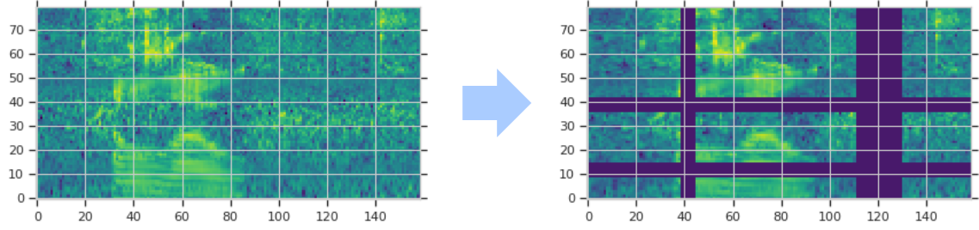
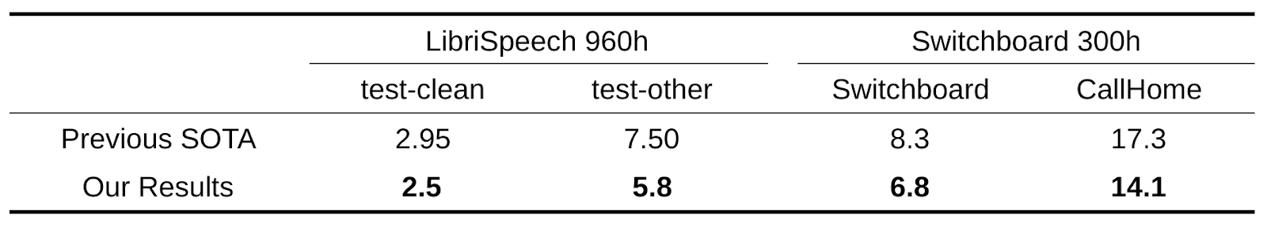
Spectral augmentation
Proposed by Google recently (https://ai.googleblog.com/2019/04/specaugment-new-data-augmentation.html)
Three types of modifications of the raw filterbank spectrogram, randomly chosen
Time warping
Masking blocks of consecutive filterbank features (horizontal)
Masking whole filterbank blocks in time (vertical)

Slide 9





Data augmentation with images
Flipping
Rotation
Translation
Scaling
Adding noise
...

Slide 10
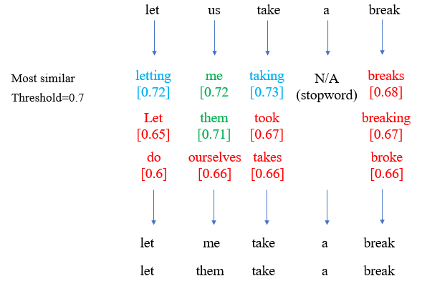
Data augmentation for NLP
For text data, data augmentation is less useful
One idea: replace words in training data with words that have similar embeddings
But usually better to just use pretrained word embeddings (or pretrained contextualized representations, like BERT)
Alternative: use domain knowledge
E.g., replace company names in text with other company names from the business registry (if having a good coverage of company names is relevant to your task)

Slide 11
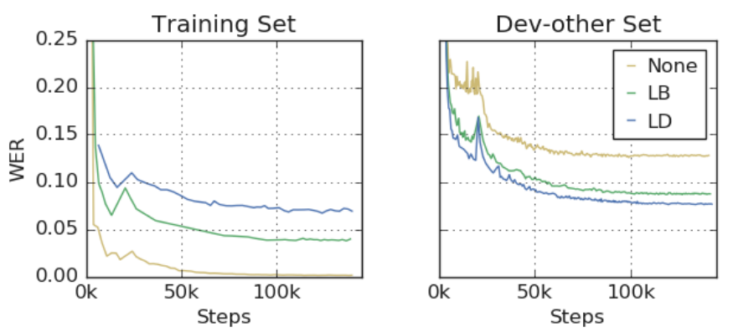
Data augmentation under-fits training data
Data augmentation turns over-fitting problem into under-fitting problem
Loss when training augmented data is worse than when training on clean data
But loss (and error rate) on test data is better
Thus, common methods that work against under-fitting help:
Using larger (wider and deeper) models
Training for more epochs

Slide 12
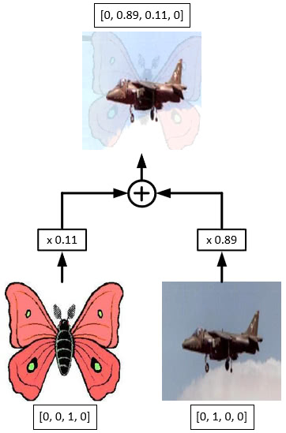
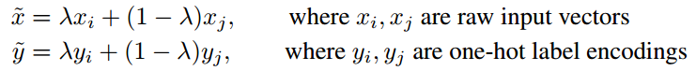
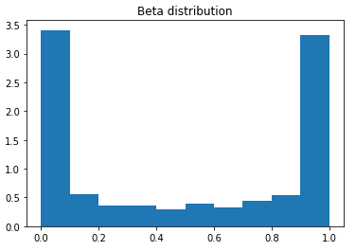
Mixup
During training, mix two training samples and the corresponding labels
The mixup factor is drawn randomly from a beta distribution
Kind of surprising that it helps
Not really applicable to text data

Slide 13
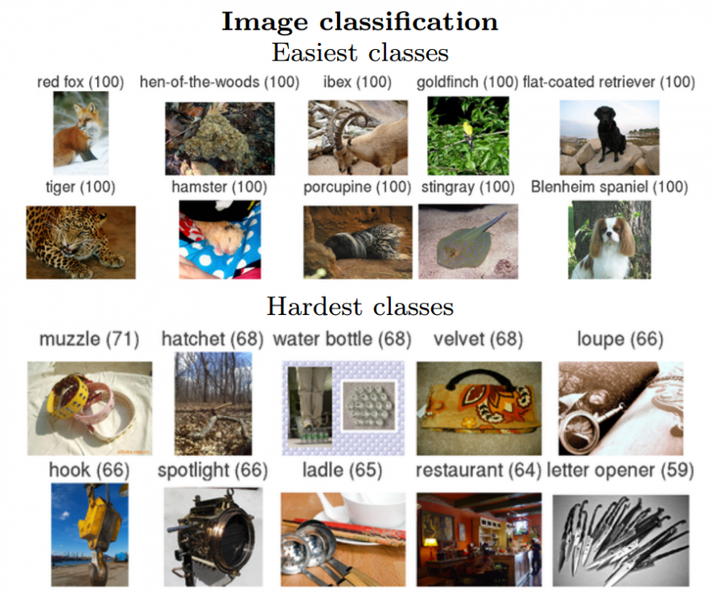
Pretraining
It rarely ever hurts to use a pretrained network if you can, even if you have enough data
Pretraining was first popularized by the image recognition community
Pretrain a ConvNet on ImageNet
ImageNet: dataset of 1.2M images, 1000 categories
Models trained on ImageNet can be used to initialize models for completely other datasets and improve performance significantly
Works even if you have only a few examples per object

Slide 14
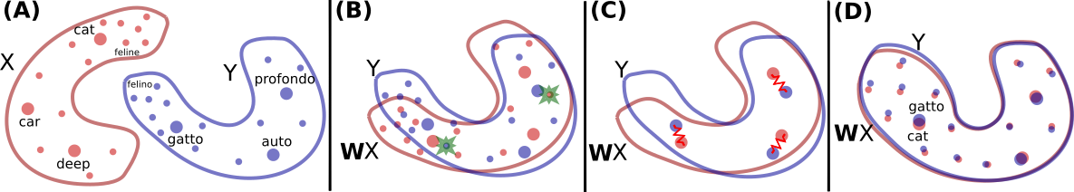
Pretraining for NLP
Pretraining can have huge benefits on NLP tasks
Pretrained embeddings
Pretrained contextualized embeddings (e.g. BERT)
Use pretrained model “found” from internet (many Estonian models available) or train your own
Cross-lingual pretraining
Main idea:
Train word embeddings for two languages (e.g., English and Italian)
Align English and Italian embeddings
Use English labeled data to train a text classification model
The model also works for Italian!
https://github.com/facebookresearch/MUSE

Slide 15
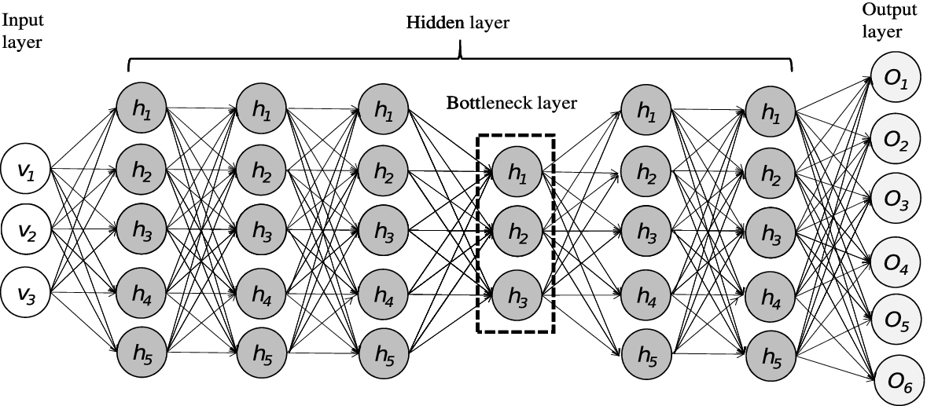
Pretraining for speech recognition
Pretraining also works for speech recognition
Example:
Train a model on a large universal corpus
Use a small corpus (e.g. 20 h) of in-domain data to finetune the model
Alternative: (multilingual) bottleneck features
Useful in a situation when you have very little data (e.g. 40h) from a particular language
Idea:
Train a DNN acoustic model on other language(s)
The DNN has a narrow bottleneck layer before the output
Use the bottleneck as a feature extractor
Train a speech recognition model on the low-resource language on bottleneck features, instead of the usual filterbanks

Slide 16
Pretraining for speaker recognition
Pretraining is crucial for speaker recognition (e.g., speaker identification and verification)
Idea:
Use a large speaker database (speech-speaker pairs) to train a speaker identification model (convolutional model with global pooling)
Use the model’s pooling layer output as a feature extractor
Now, use the feature extractor to get speaker embeddings (called x-vectors) for speakers you need to cover
Only a few sentences per speaker is now enough

Slide 17
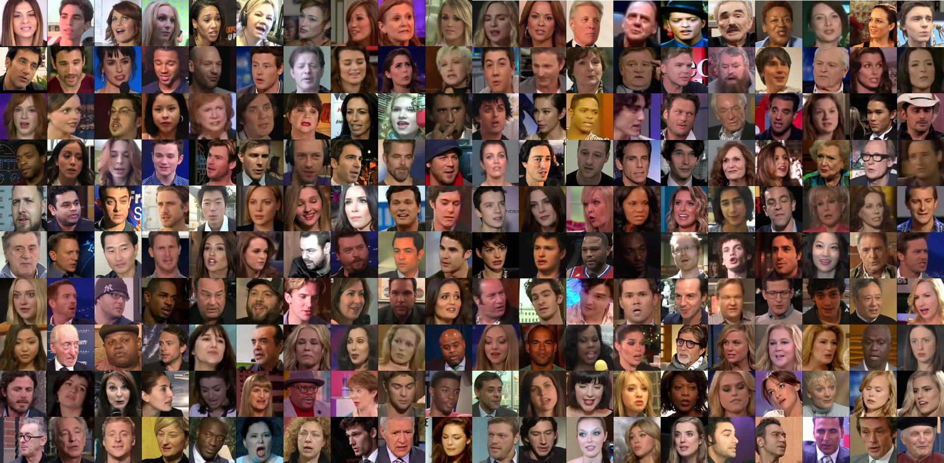
VoxCeleb
But how to get the “large speaker database”, needed for training the voice feature extractor?
VoxCeleb:
Query YouTube, using e.g. “Elon Musk interview”
Use Face Recognition to identify frames where Elon Musk is in the frame
Use lip-syncing to check that lips and audio are in sync
Extract all such frames and use this as training data
Alternative: given several videos of Elon Musk, the segments where he is speaking can be found automatically (invented in our lab, based on a Master thesis)

Slide 18
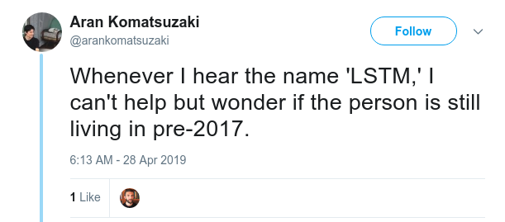
What model to use in NLP?
What model to use for NLP task (e.g. text classification, information extraction), given that you have reasonable amount of training data?
For most NLP tasks, Transformer (multi-layer multi-head attention with position encodings) is currently the best choice
For English, use BERT for getting contextualized word embeddings
For Estonian, train your own BERT?

Slide 19
Debugging neural networks
Neural net training fails silently
Tricky to unit test
Your net can still (shockingly) work pretty well even if your training data is corrupted somehow
E.g., maybe you feed it columns instead of rows of data
It’s because neural nets can memorize the data to some extent
Most of the time when you screw something up, it will train but silently work a bit worse

Slide 20
Recipe for training neural nets
Verify your data
Start with simple models
No data augmentation, fancy learning rate schedules, etc
Train an input-independent baseline, (e.g. easiest is to just set all your inputs to zero)
This should perform worse than when you actually plug in your data without zeroing it out. Does it?
Overfit a single batch of only a few examples (e.g. as little as two).
Verify that we can reach the lowest achievable loss (e.g. zero)

Slide 21
Recipe, continued
Don’t be a hero
Start with a model that is known to give good results on similar tasks
You’re allowed to do something more custom later and beat this
One complexity at a time
At fanciness to your model one by one and make sure it improves the model
Leave learning rate tuning to the end

Slide 22
Recipe, continued
Regularize (avoid overfitting)
Try to get more data
Data augmentation, try to be creative
Pretraining rarely hurts
Unsupervised learning usually gives very little improvement, and is very complicated
Try with less features
Try smaller model size
Add dropout
Add L2 regularization (weight decay)
Early stopping
Try larger model, but stop early

Slide 23
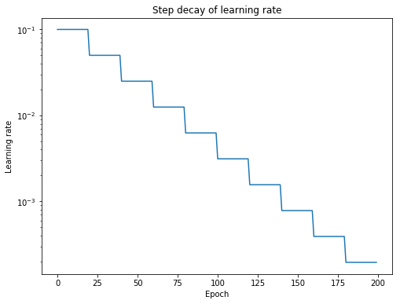
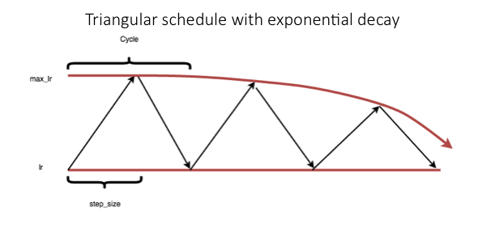
Some tricks: learning rate schedule
Learning rate schedule
E.g., step decay (0.1 at the beginning, 0.0001 at the end)
Or: constant learning rate, but decrease it when the loss on dev data doesn’t decrease any more (ReduceLROnPlateau in Pytorch)
More recent: triangular learning rates
Start at learning rate 0.001
Gradually increase it to 0.01 at epoch 25%
Then gradually decrease it until the end
Cyclic learning rates

Slide 24
Some tricks: dropout, label smoothing
Similarly to learning rate, dropout can be also scheduled
E.g.: 0 dropout at the beginning,
Increase dropout gradually to 0.3 at epoch 50%
Then gradually decrease it back to 0
Label smoothing
Very simple idea: redistribute 0.1 of probability mass from the correct label to all other labels
Often used in Google’s papers
Results in less loss fluctuations on dev data during epochs in my experience
Maybe disable label smoothing during the last training phase

Slide 25
Ensembles
Model ensembles are a pretty much guaranteed way to gain 2% of accuracy on anything
Ensembles of models of different architecture result in the best performance
Even if a particular model is relatively bad (compared to the best ones in the ensemble), combining its predictions with others can give surprising gains
If you can’t afford the computation at test time, try distilling your ensemble into a network using dark knowledge
Compute posteriors (target probabilities) for your training data using the ensemble, and train a final model on the posteriors (instead of real targets)
This way, the final model learns to mimic the ensemble

